Slide 1

To Do List App

Slide 2
Agenda
Introduction
Design Analysis (including OOP Design )
Use Case Diagram, Class Diagram, Activity Diagram
Agile Project Methodology
Pair Programming, Code Review, Git and GitHub
Progressive Testing ( Test Driven Development)
App Demo
App main features
Additional features
Weather API - Open Weather
Unplash API
Light and Dark mode
Drag and Drop API
Lessons learned

Slide 3
Design Analysis
Sprint -2
Task 4- Task Form Input Validation
Task 5 – Display the Current Date
Task 6 – Create a Class and Add Tasks
Sprint-3
Task 8 – Update Tasks
Task 9 – Persisting Task with Local Storage
Task 10 – Deleting Tasks
Task 7 – Display Tasks

Slide 4

OOP Design : Use Case Diagram
Use Cases
Render
Add task
Edit Task
System
Delete Task
User
Save tasks
Mark as Done
Local Storage/ Database

Slide 5
OOP Design : Class Diagram
Task Manager
+ tasks : Array + currentId : number
- addTask( ) - editTask( ) - deleteTask( ) - createTaskHTML( ) - formatStatus( ) - render( ) - getTaskById( ) - save( ) - load( )
UML Conventions
ClassName
property_name : type
method( ) : type

Slide 6
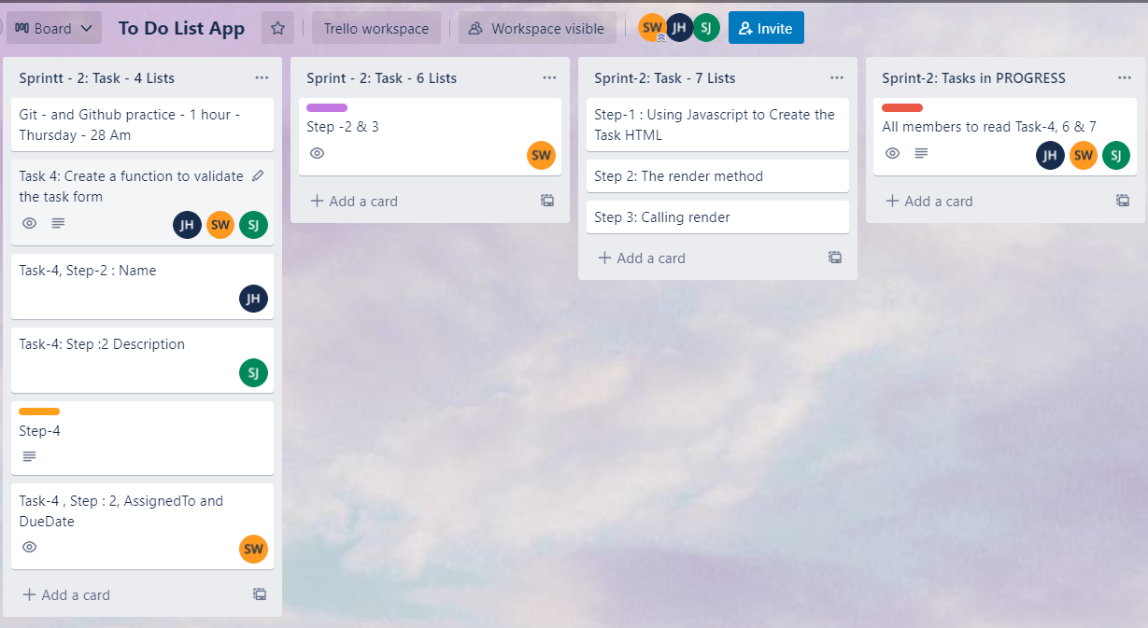
Agile Project Methodology

Slide 7
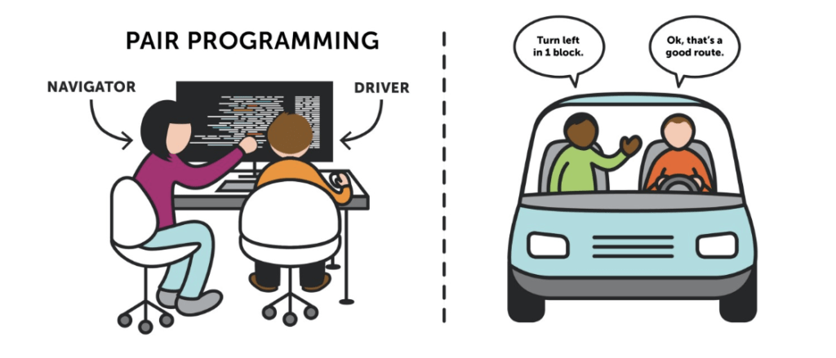
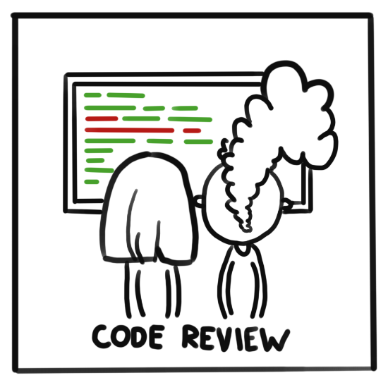

Agile Project Methodology

Slide 8
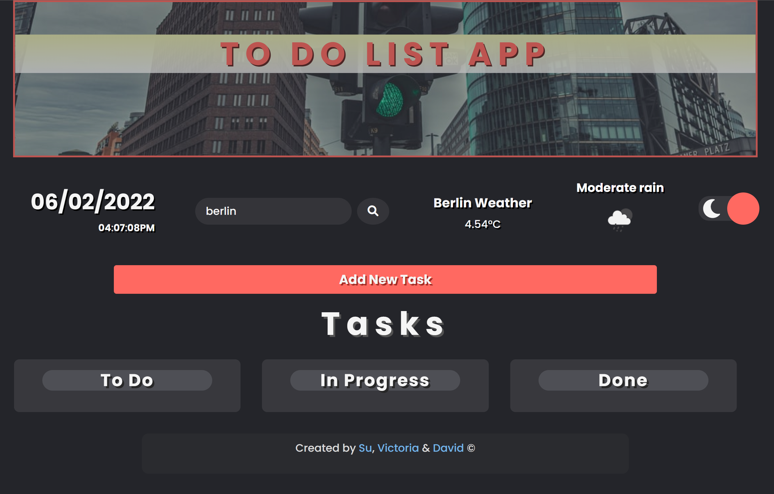
To Do App Demo

Slide 9



Additional Feature : Weather API
Weather Data display
4
Search Weather
To Do List App calling
Open Weather API
1
3
2
API fetch and access data

Slide 10
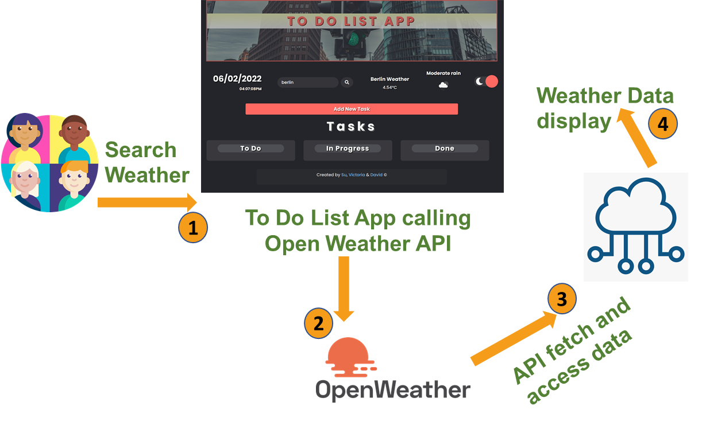
Additional Feature : Weather API
Create account to generate apiKey
Async await → fetch data
.json( ) → read and parse the data

Slide 11
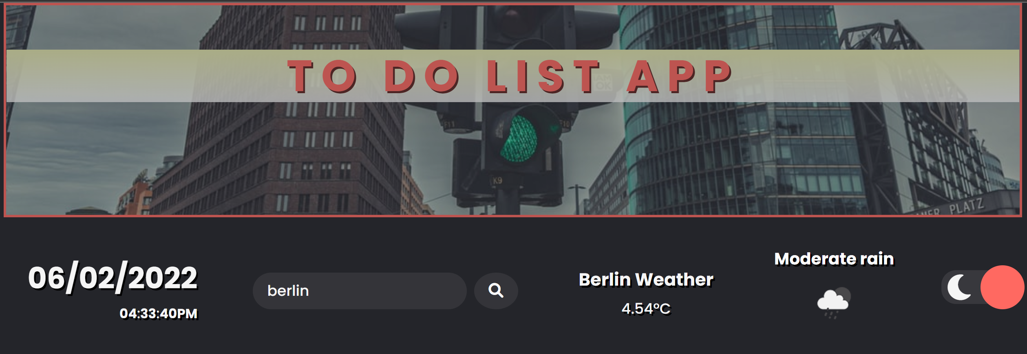
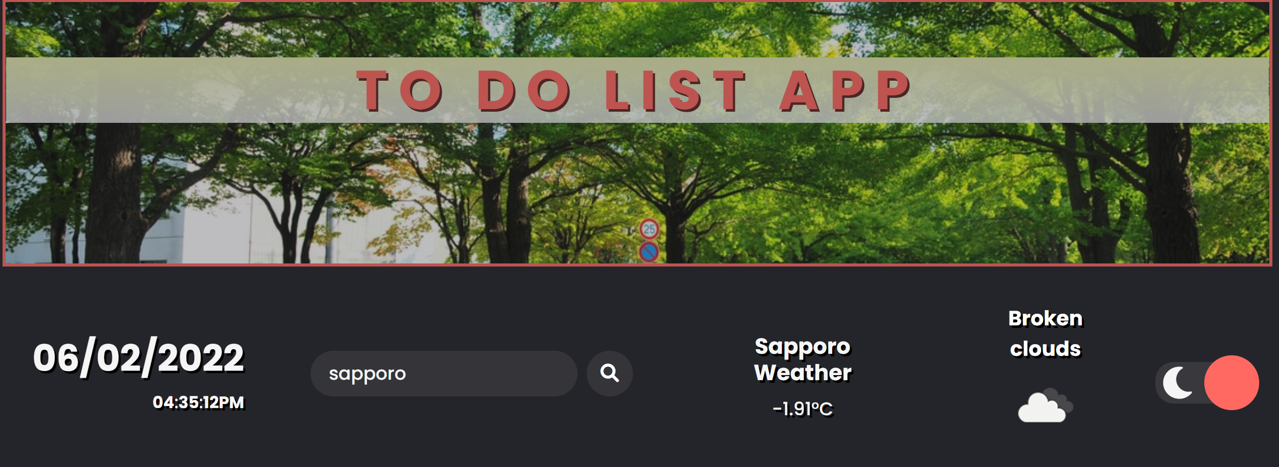
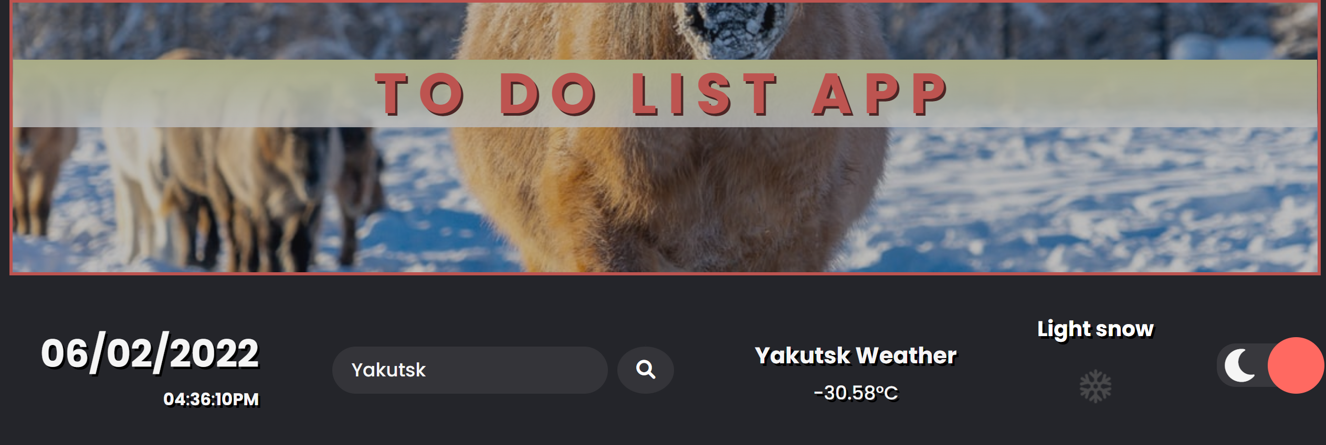
Additional Feature : Unplash Image API
document.querySelector(".heading").style.backgroundImage = "url('https://source.unsplash.com/1110x400/?" + name + ")";

Slide 12





Additional Feature : Light and Dark mode
<input type="checkbox” class="checkbox" id="checkbox" />
Font awesome – moon and sun
Light-dark toggle
Checkbox click event
🌙
🌞

Slide 13
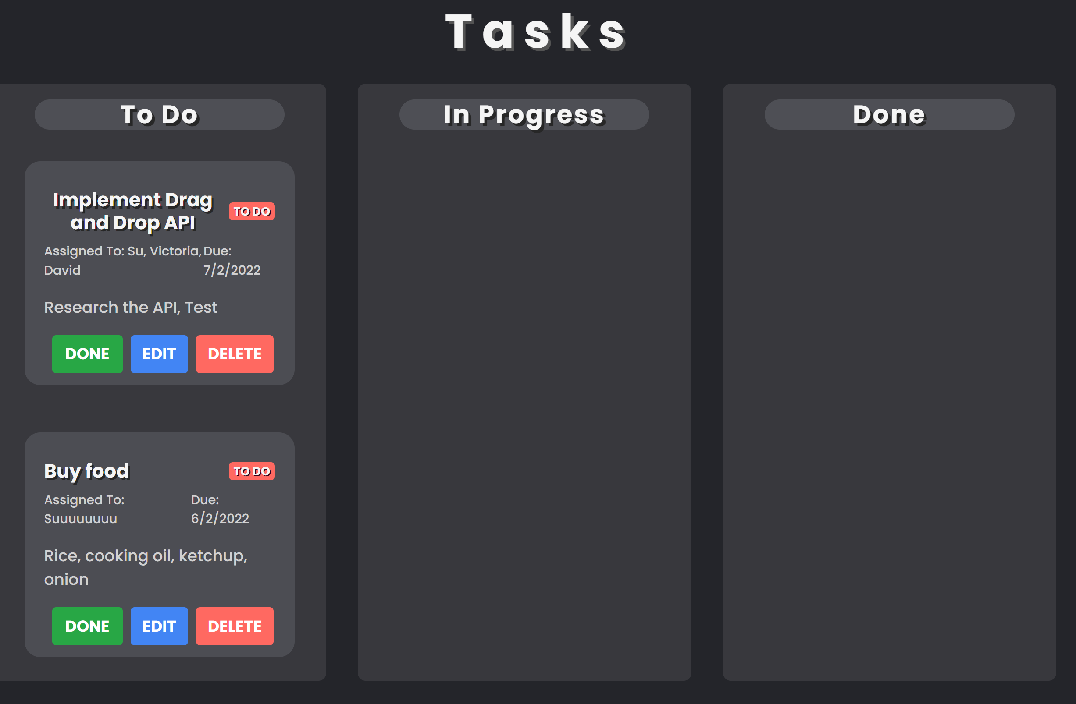
Additional Feature : Drag and Drop API
Each To Do list needs to be Draggable
Drop Target

Slide 14
Additional Feature : Drag and Drop API
Draggable
Drop Target
Events
dragStart
dragOver
dragEnter
Attributes
ondragstart="dragStart(event)" draggable="true”
Events
dragOver
dragDrop
Update status
save( )
render( )

Slide 15
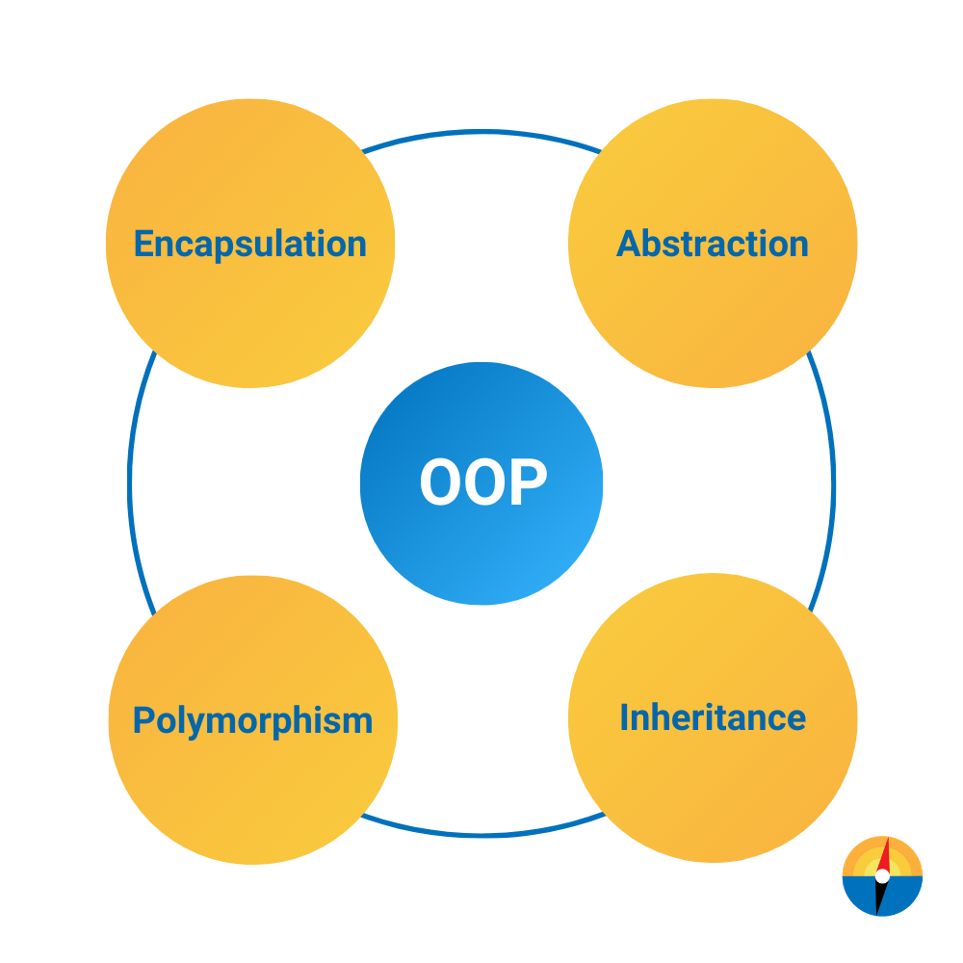


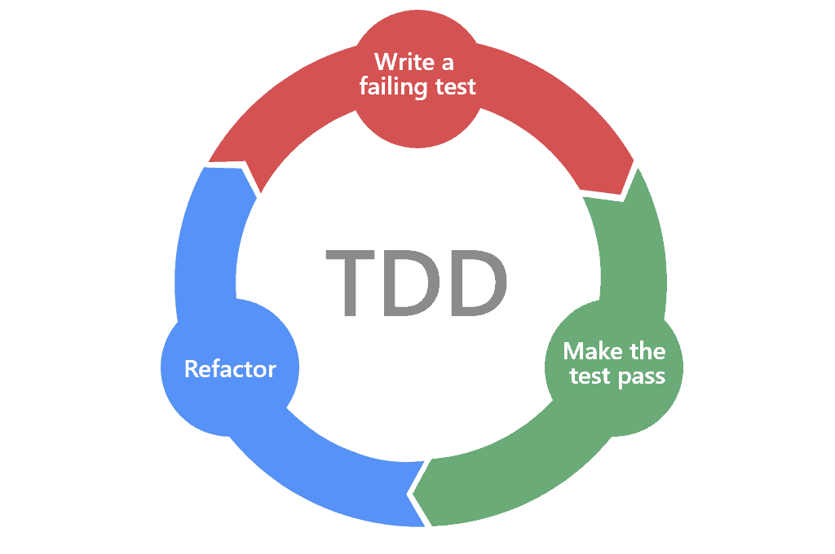

Lessons Learned
Agile Project Methodology & Team Work
Debugging Sills
+ What TDD is
JavaScript + API calling
OOP Design Principles

